Slide 1
Attendance system for faculty using facial recognition
-Team CodeHers

Slide 2
Stepwise development of project
Detecting face
Posing and Projecting Faces
Encoding faces
Finding person’s name from the encoding
Details in database- Name and Time

Slide 3
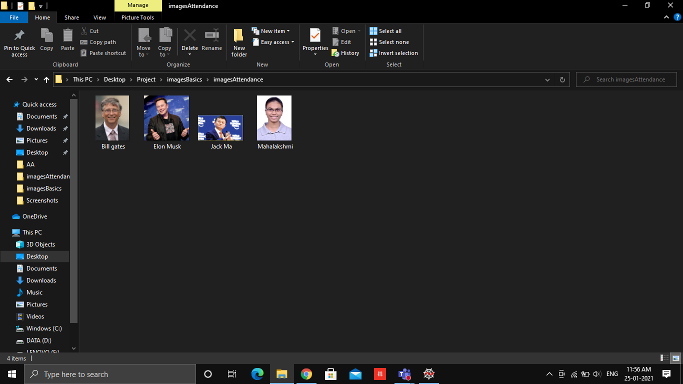

Slide 4
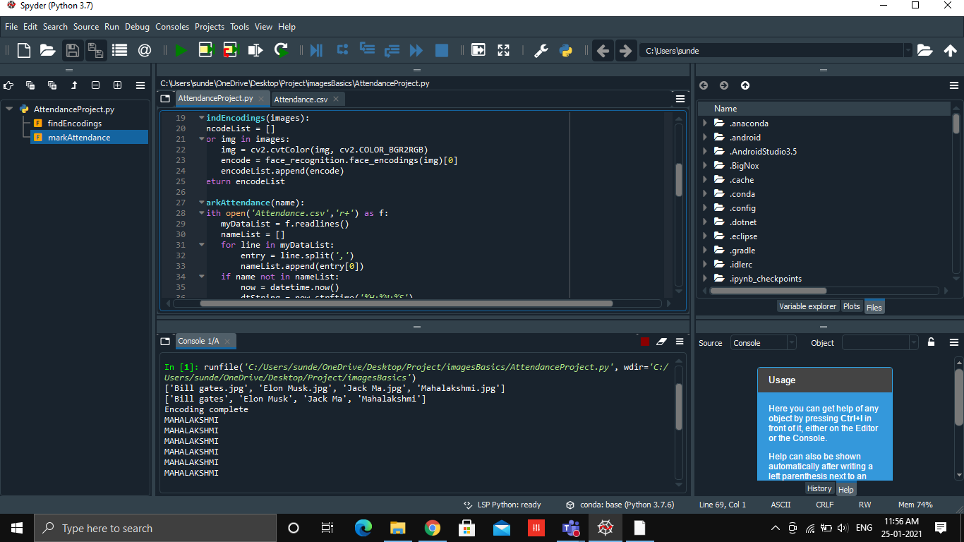

Slide 5
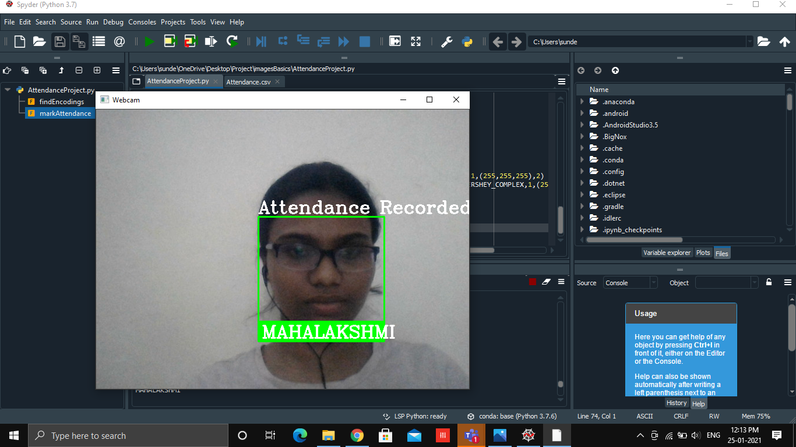

Slide 6
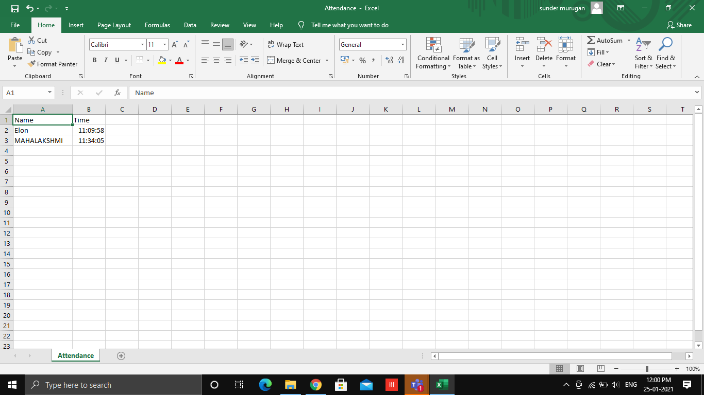

Slide 7
Future scope
Time out feature
Calculation of total working hours
Calculation of extra wages (if working for extra hours)

Slide 8
Thank you

